Slide 1
Enhancing Security in SMS by combining NLP models using Ensemble Learning for Spam Detection with Image Steganography Integration
Aditya Kumar
Dr. C. Fancy
SRM Institute of Science and Technology, Kattankulathur

Slide 2
Abstract
SMS Spam is sent by scammers trying to phish on people where they send a message to the victim saying that they have won something and want the victim to click on a malicious link to steal data or access the victim’s device. By creating multiple models for spam detection and combining the best performing models using ensemble learning techniques would give us a model which would predict a text message from spam and legitimate with much more accuracy. The model will be integrated into image steganography tool to hide message and keep it more secure in transit.

Slide 3
Introduction
Ensemble learning is a type of learning in AI/ML where multiple different models are used and then their different outputs are combined to give a final result.
By using the concept of ensemble learning, we can train multiple models and choose the ones with very high accuracy and precision and use those models together to get a model which gives a more accurate prediction.
As SMS has turned into MMS nowadays, sending images with hidden text using steganography can be used to provide another layer of security in text messages.

Slide 4
Challenges and Limitations
While combining the multiple models, we will need to choose the ones such that the accuracy does not decrease with keeping the precision of the model as high as possible as well. And even after creating the model, the model would still need constant training on new dataset including data generated and classified by the user themselves. Even after creating the model, it has been done so many times that attackers come up with newer phishing techniques. To prevent this, we implement an image steganography tool which can help double the security of the message while in transit.

Slide 5
Objectives of the project
The main goal of this project is to create an ensemble model with higher accuracy than its base models without losing precision of the model. Using the models that give 100% precision, we would take them as base models such that the final model can classify text messages as accurately as it can while avoiding false negatives. SMS apps can be modified such that instead of sending encrypted text messages, they send text messages hidden in images. The app would hide the text message in the image while transmitting it and will de decoded when received, even if an attacker figures it out the spam detector model will catch the message.

Slide 6
Innovation
The SMS spam detection models that have been previously created have not been created using ensemble learning techniques, i.e. current models have only been used creating Naive Bayes algorithm. By using AI model for spam detection and coupling it with image steganography to send modern sms messages so that they are harder to decrypt. Even if they are implemented in applications, they are only detecting spam and not preventing it. By creating an image steganography tool with the AI model, the text message will be hidden in an image, also providing security over the already encrypted text channel.

Slide 7
Scope and Application
The dataset will be preprocessed and features will be extracted such as number of words, letters and sentences. The words of texts will be stemmed and removing the stopwords after which the dataset will be trained on different Naive Bayes variants and the best performing model will be selected as the base models and other models including Random Forest, K nearest neighbors and more will be tested and the best performing models will be selected for the ensemble model.
The Image Steganography tool will be implemented with the custom model created and will be able to detect if the incoming message is spam or legitimate while decrypting it.

Slide 8
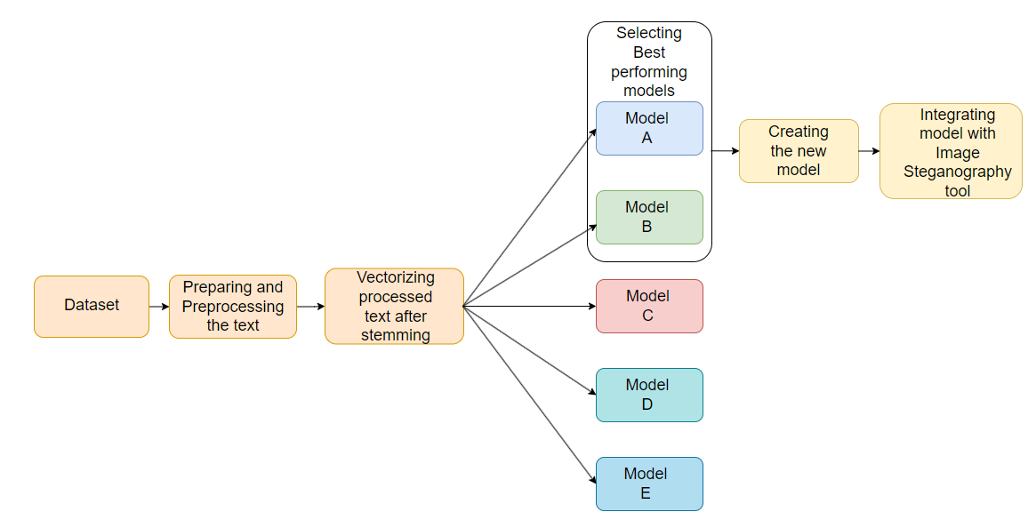
Proposed Architecture

Slide 9
Results
The best performing algorithmic models were found to be K Nearest Neighbours, Naive Bayes and Random Forest.
Model | Accuracy | Precision
KNN | 90.60% | 100%
NB | 97.38% | 98.23%
RF | 96.89% | 100%

Slide 10
Results
Stacking technique was used to combine these models with NB as base model and custom model KNR was obtained which has 97.48% accuracy and 94.26%. There was 0.1% increase in accuracy and while the precision was not 100%, higher accuracy was preferred over high precision. KNR model was then successfully implemented with the Image Steganography tool.

Slide 11
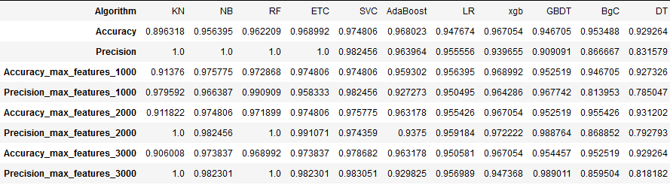
Results

Slide 12
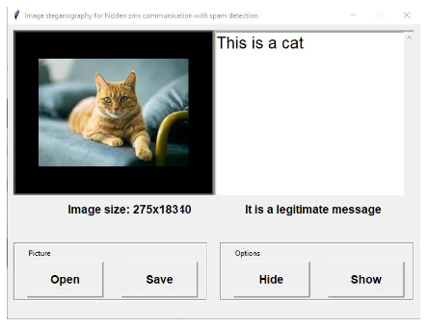
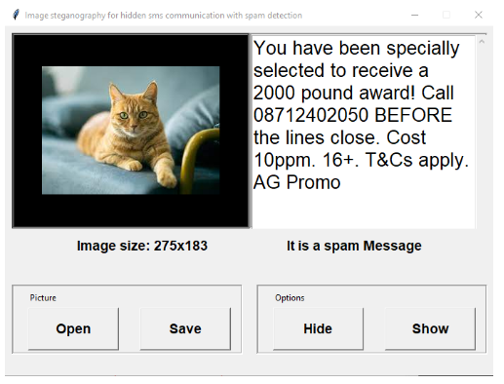
Results

Slide 13
Future Enhancements
Reinforced learning technique can be use to take feedback from the user to judge if the spam detection model labelled the text message correctly or not.
While the dimension of the image selected image will need to be limited, Spread Spectrum and Phase Encoding can be used instead of LSB but would need to tackle data corruption due to image compression while in transit.
This technology could be integrated with popular sms services such as Google and Apple Messages but the detection model would require multiple GB’s worth of datasets if it were to be implemented with such a big application

Slide 14
Conclusion
In this project, we created and compared several algorithms for Spam Detection and created a custom model KNR from the best performing models.
The Image Steganography tool using 1 bit LSB technique showed no hidden data corruption when dimensions of cover image were undefined.
The implementation of KNR model with Steganography tool was successful and the objective of this project were achieved.
We believe this study can contribute to further security improvement techniques in the field of messaging and provide as a good comparison between algorithmic models for sms spam detection.

